Slide 1
MongoDB- Storing Reviews Tutorial – 3, Download, Set up and Implementation
CSP 584 – Enterprise Web Application
Dr. Atef Bader
Illinois Institute of Technology
- Presentation By
Pradeep Kumar Lokesh

Slide 2
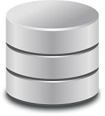

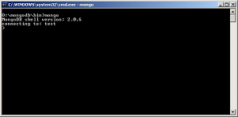
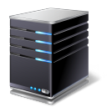
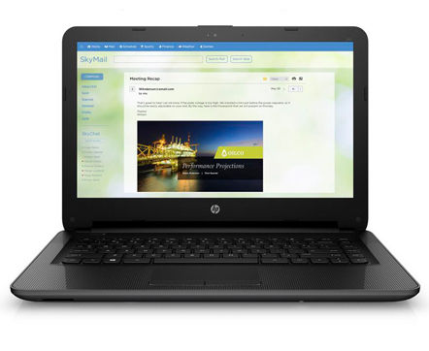
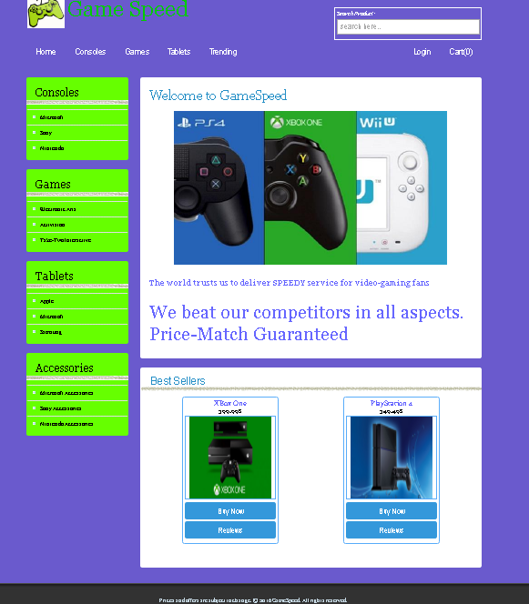


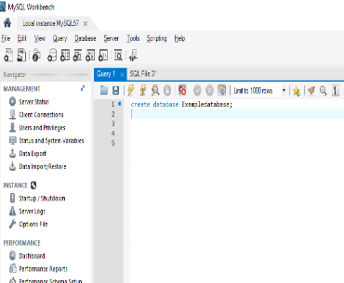
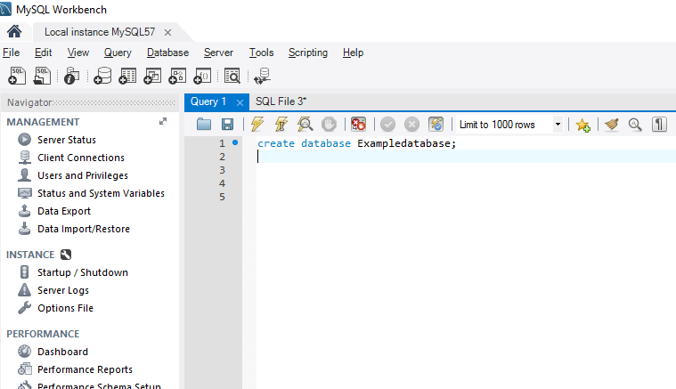
The Architecture - MVC
Database
7
Product Reviews
1
2
3
Internet
6
Database Servers
4
Client
App Server
Database
5
Table 2
Table 1
Customer
Orders
Registration

Slide 3
1. Mongo DB - Overview
Mongo DB is a cross platform, document oriented database
Mongo DB works on the concept of Collections and documents
Terminologies:
Database: This is the physical container for the collections
Collection: Collection is a group of Mongo DB documents
Document: Document is a set of key – value pairs
Advantages:
Schema-less: The number of fields, content and size of the document can vary from one another
Scalability: Mongo DB is easy to scale

Slide 4
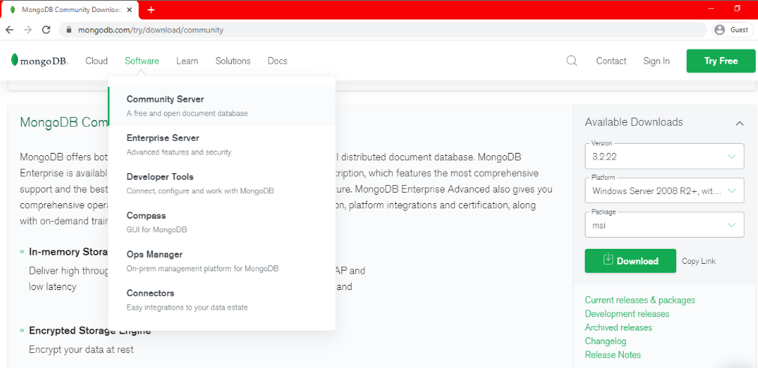
2. Mongo DB - Download
Go to https://www.mongodb.com/ and click on the ‘Products’ button and select Mongo DB Server under the software to download Mongo DB (Direct Link : https://www.mongodb.com/try/download/community)
Click on the Community Server for downloading MongoDB

Slide 5
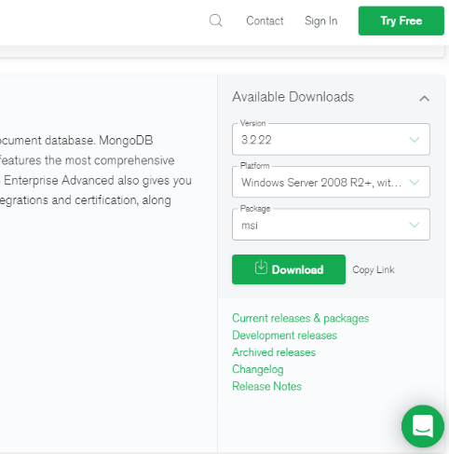
2. Mongo DB - Download
Select the Version, Platform as Windows and the version as ‘Windows Server 64 – bit 2008 R2 64 bit and later with SSL support x64’
Click on the ‘Download’ to begin the download
Click on the Download Button

Slide 6
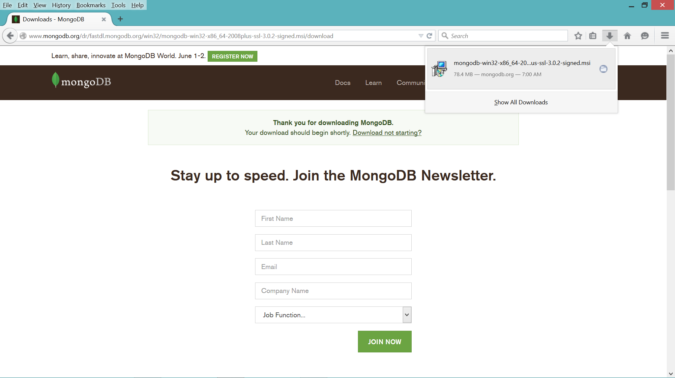
2. Mongo DB - Download
Please note the location of the folder where MongoDB is being downloaded

Slide 7
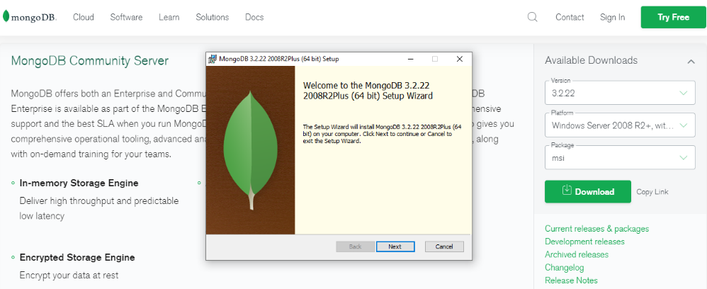
3. Mongo DB - Setup
To start the installation, go to the folder where MongoDB has been downloaded and double click on the installation file
This should open the MongoDB setup wizard as shown below
Click on ‘Next’ to proceed with the installation

Slide 8
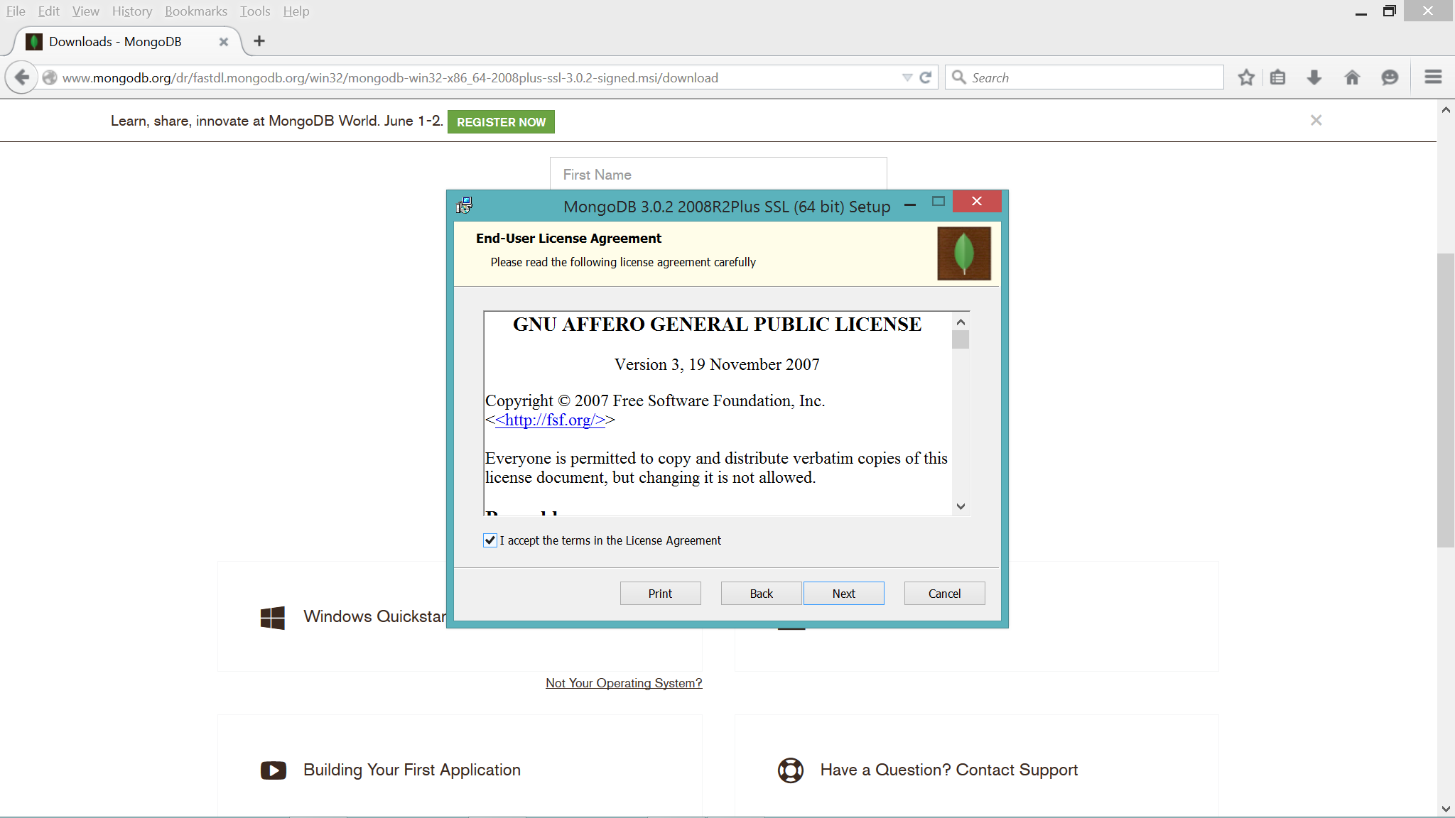
3. Mongo DB - Setup
Accept the license agreement and proceed by clicking on ‘Next’

Slide 9
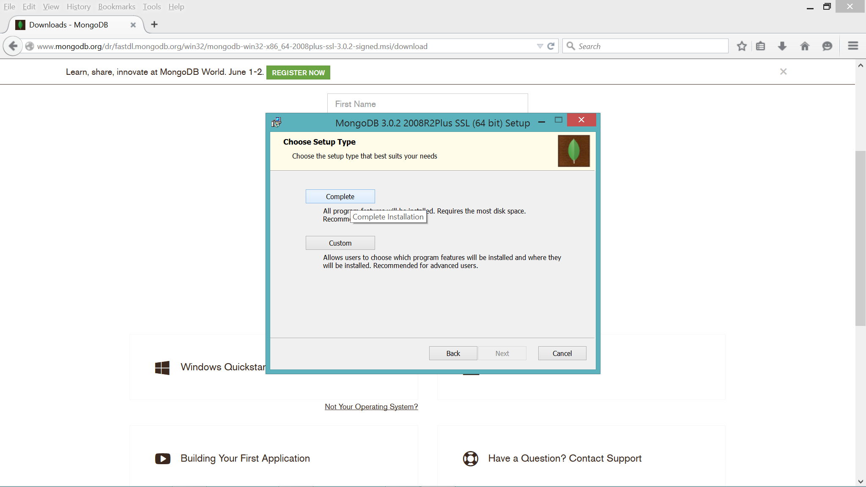
3. Mongo DB - Setup
Select the setup type as ‘Complete’ and then click on ‘Next’
Since we are at the beginners level with MongoDB, hence, it is recommended that you select the setup type as ‘Complete’

Slide 10
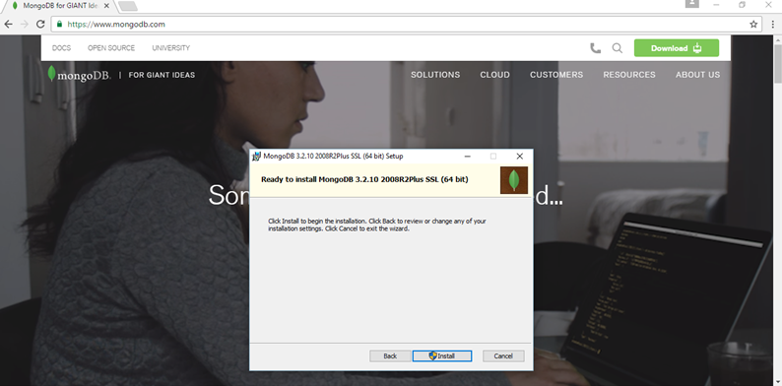
3. Mongo DB - Setup
Click on install to install Mongo database

Slide 11
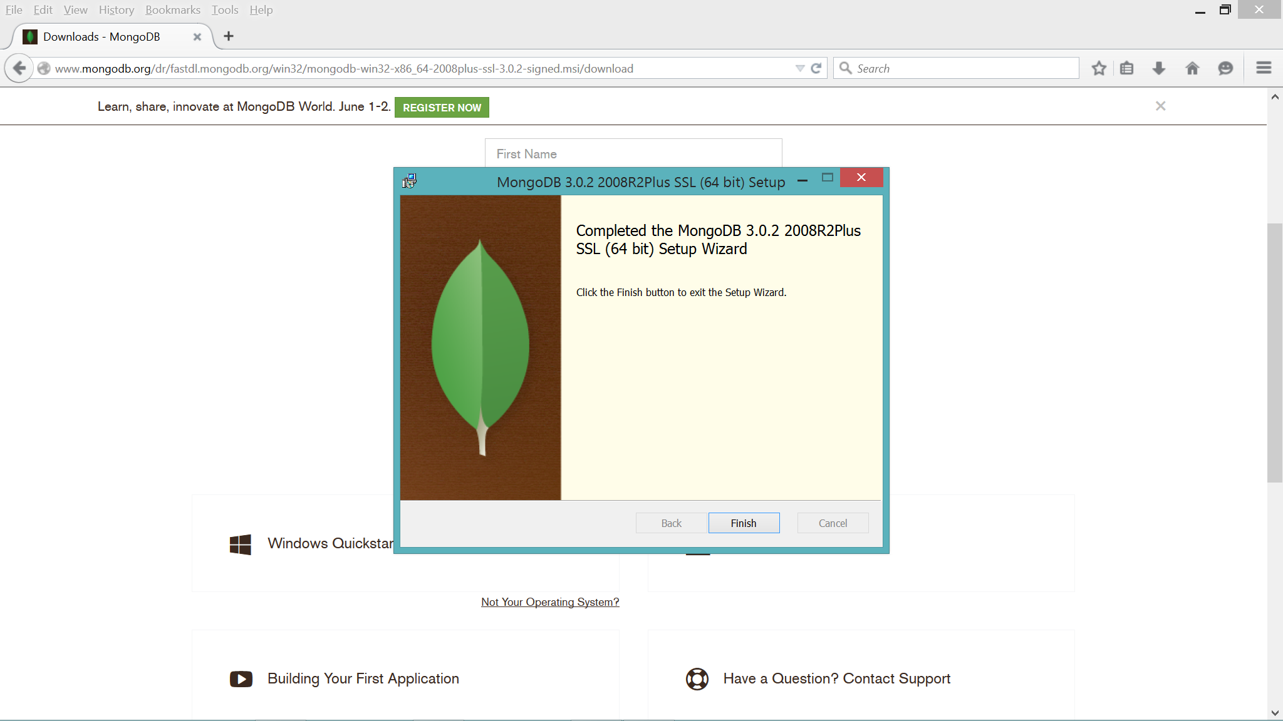
3. Mongo DB - Setup
Once the installation is complete, click on ‘Finish’ to complete the process

Slide 12
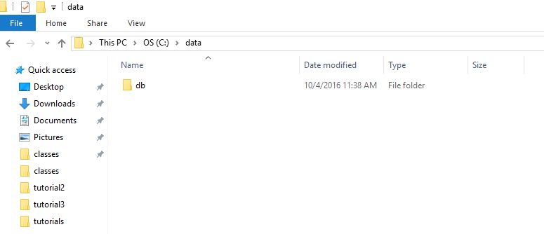
4. Mongo DB – Startup Instructions
Create a data and db folder inside C drive as c:\data\db
Make sure that you directly create data\db folder inside c drive only

Slide 13
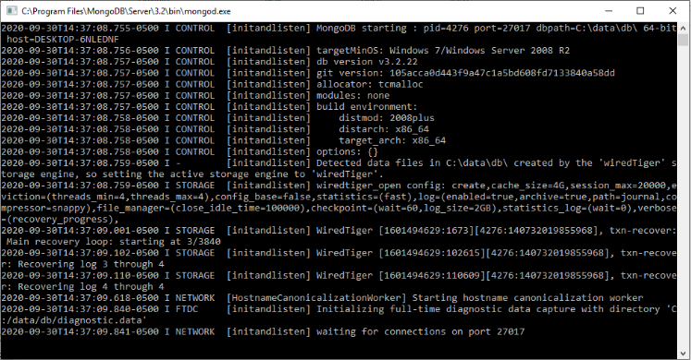
4. Mongo DB – Startup Instructions
To start Mongo DB, open command prompt and enter the command ‘mongod’ .
Mongo DB is usually installed under C:/Program Files/MongoDB
To start Mongo DB server process , locate the “mongod.exe” stored in C:\Program Files\MongoDB\Server\3.2\bin and click it.

Slide 14
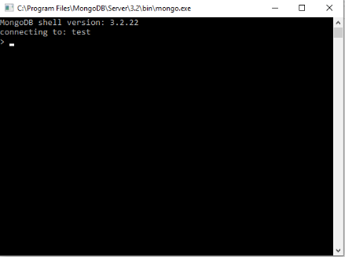
4. Mongo DB – Startup Instructions
To start Mongo shell, open command prompt and enter the command ‘mongo’
Mongo DB is usually installed under C:/Program Files/MongoDB
To start Mongo shell, locate the “mongo.exe” stored in C:\Program Files\MongoDB\Server\3.2\bin and click it.

Slide 15
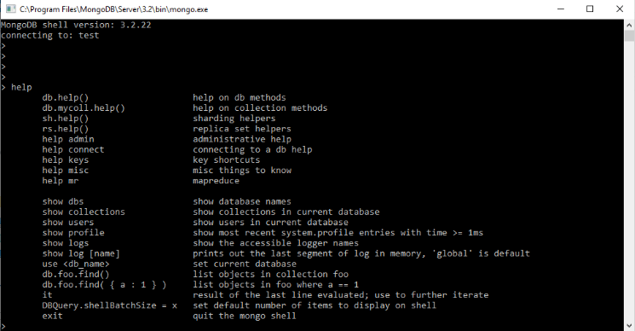
4. Mongo DB – Help command & Documentation
The ‘Help’ command is a very handy command and can be used to check various commands available with Mongo DB
To learn more on MongoDB Commands , visit: https://docs.mongodb.com/manual/reference/mongo-shell/

Slide 16
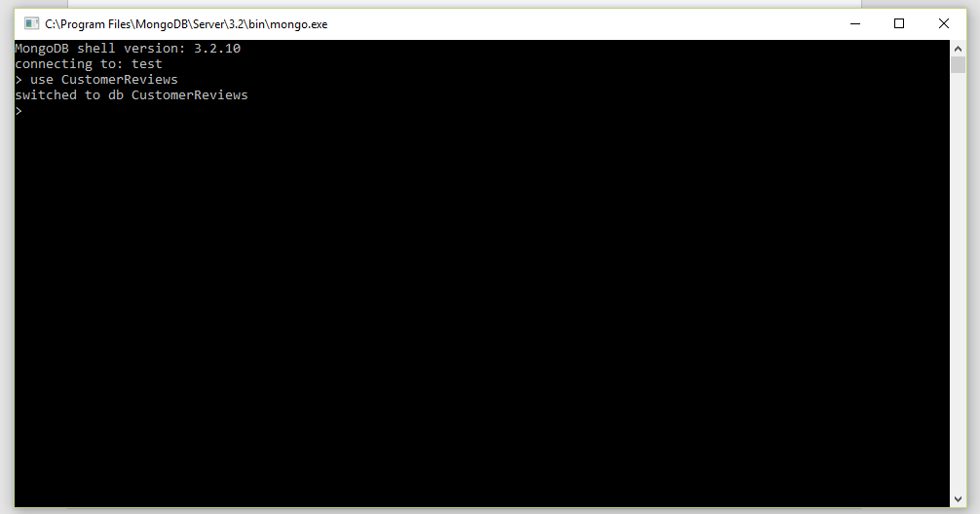
4. Mongo DB – Use a database
In order to use a database, you must select it first
To select a database along with the startup, use the command ‘use databasename’
Example, to select the ‘CustomerReviews’ database, the command is ‘use CustomerReviews’
You can then check the db you are in by typing db command

Slide 17
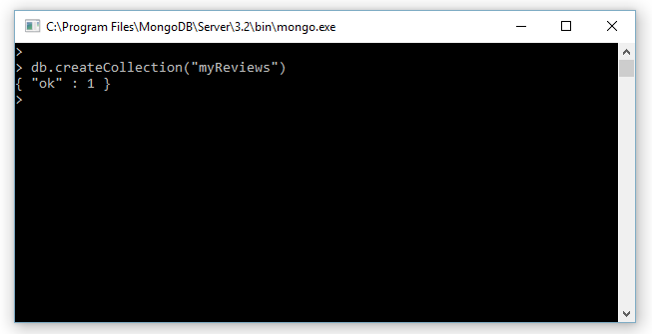
4. Mongo DB – Create Collections
You can manually create collection or automatic by running your java program
To create a collection manually type db.createCollection(collectionname)

Slide 18
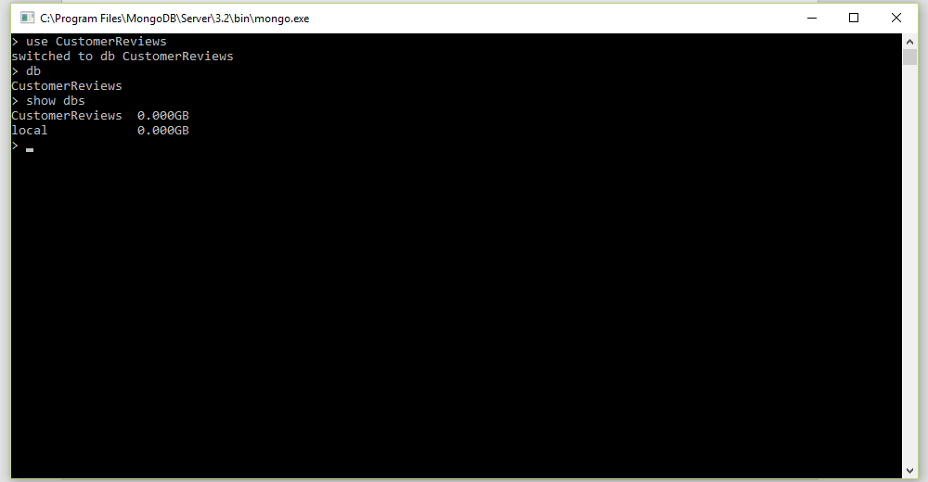
4. Mongo DB – Display list of available databases
To check the databases that exist, use the command ‘show dbs’
This will show the list of available databases

Slide 19
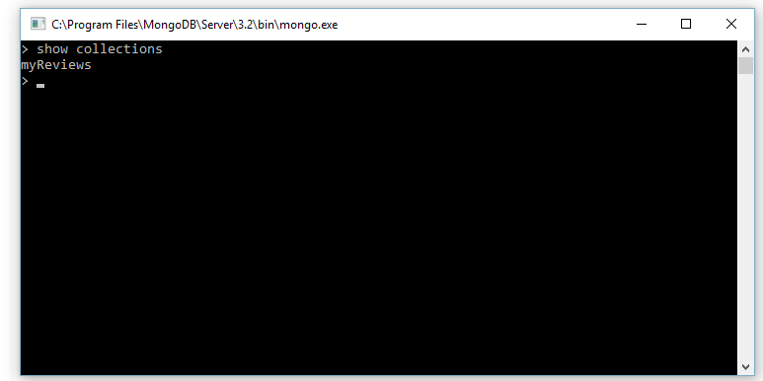
4. Mongo DB – Show collections
Use the command ‘ show collections’ to view the list of available collections in the selected database

Slide 20
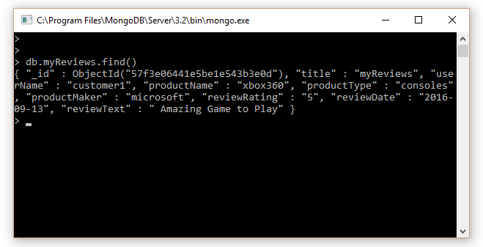
4. Mongo DB – Query data
In order to query data, use the command ‘db.COLLECTION_NAME.find()’
The find() queries the data available in the selected collection.
Example, to query the ‘myReviews’ collection we use the command ‘db.myReviews.find()’

Slide 21
5. Compile and run
You need to include all the JAR files before you compile your Java program which imports external libraries (Such as Servlets, MongoDB in this tutorial)
To download MongoDB Connector jar go to http://mongodb.github.io/mongo-java-driver/?_ga=1.142913397.1760375742.1470875192
To see the documentation for Java MongoDB Driver go to https://docs.mongodb.com/drivers/java
To include these external JAR files, make the changes to the ‘CLASSPATH’ variable in your ‘env-setup-for-tomcat_backup.bat’ file
Locate and copy the location of the JAR files on your computer and edit the ‘CLASSPATH’ variable accordingly
NOTE: Make sure you have the necessary JAR files on your computer

Slide 22
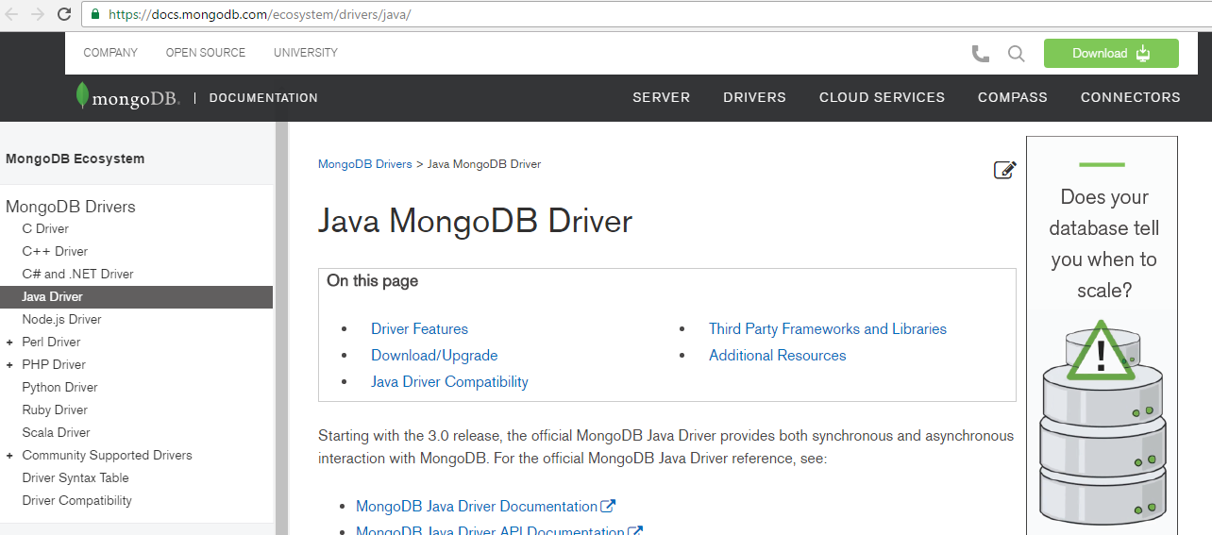
5. Compile and run
Go to https://docs.mongodb.com/drivers/java to see documentation for Java MongoDB Driver .

Slide 23
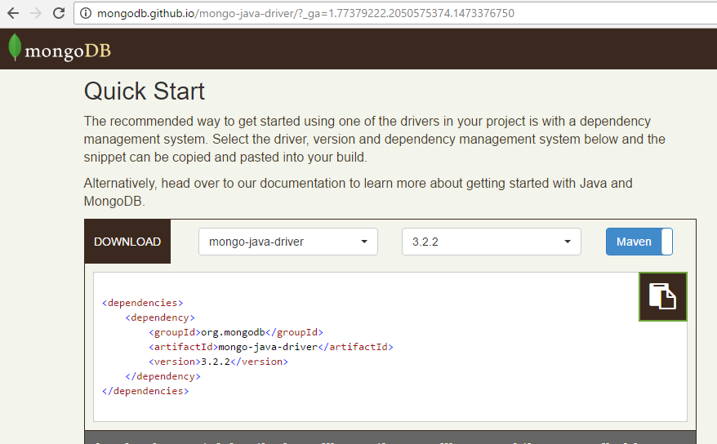
5. Compile and run
Go to http://mongodb.github.io/mongo-java-driver/?_ga=1.142913397.1760375742.1470875192 to Download jar File.
Select mongo-java-driver and version 3.2.2 and click Download Button. (Direct link: https://repo1.maven.org/maven2/org/mongodb/mongo-java-driver/3.2.2/)
Click on the download button for downloading Mongo java Driver

Slide 24
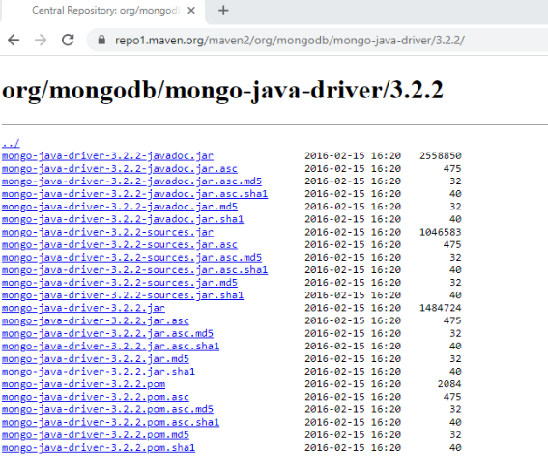
5. Compile and run
To download click on mongo-java-driver-3.2.2.jar
Click on the link for downloading Mongo java Driver

Slide 25
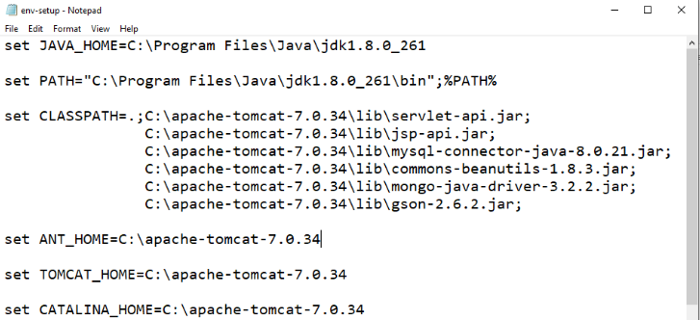
5. Compile and run
Here is the snapshot of my ‘env-setup-for-tomcat_backup.bat’
The location of the JAR files highlighted will differ based on where they are present on your computer. Please make sure you do the changes accordingly
For Tutorial_3 to work, you also need to install gson-2.6.2.jar into the TOMCAT_HOME\lib folder and give the path into env-setup-for-tomcat_backup.bat or class path in system similarly to this (https://repo1.maven.org/maven2/com/google/code/gson/gson/2.6.2/)

Slide 26
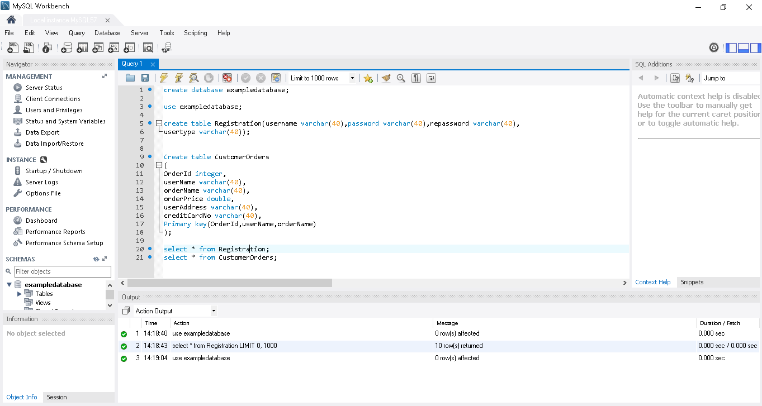
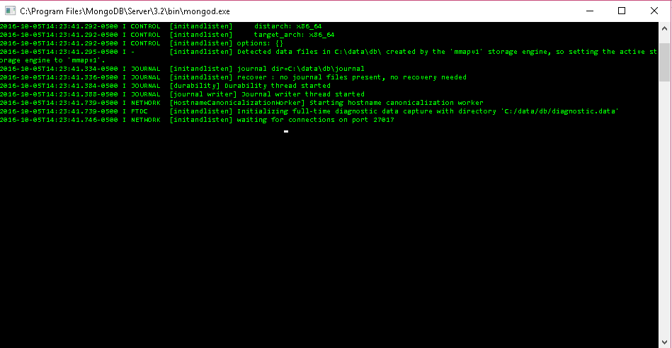
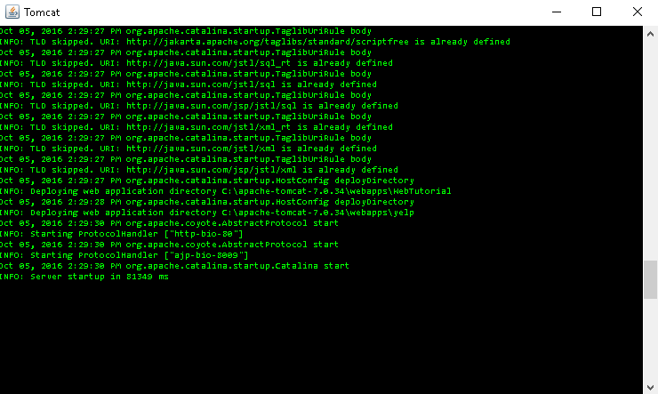
Things to Remember Before Running your Application in localhost:
Check MySQL Server is up and Running or else start the MySQL Server .
Check MongoDB Server is up and Running or else start the MongoDB Server .
Check Apache Tomcat is up and Running or else start the Apache Tomcat .
1
2
3

Slide 27
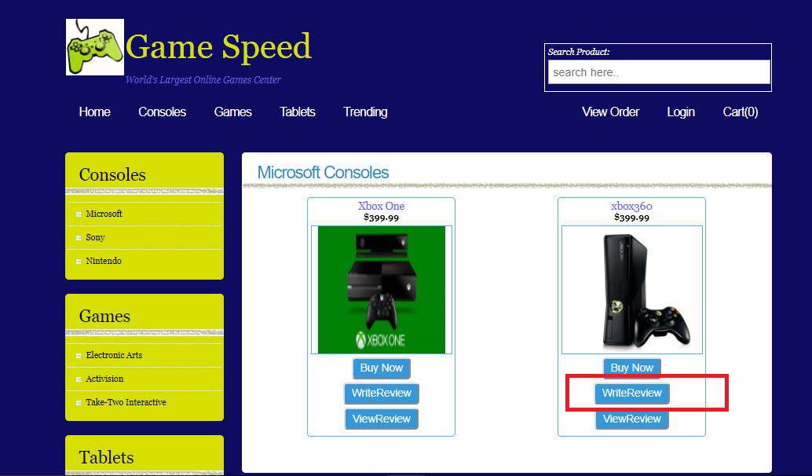
6. Example – Write Review:
To write a review for the product, click on ‘Write Review’ button on the products page

Slide 28
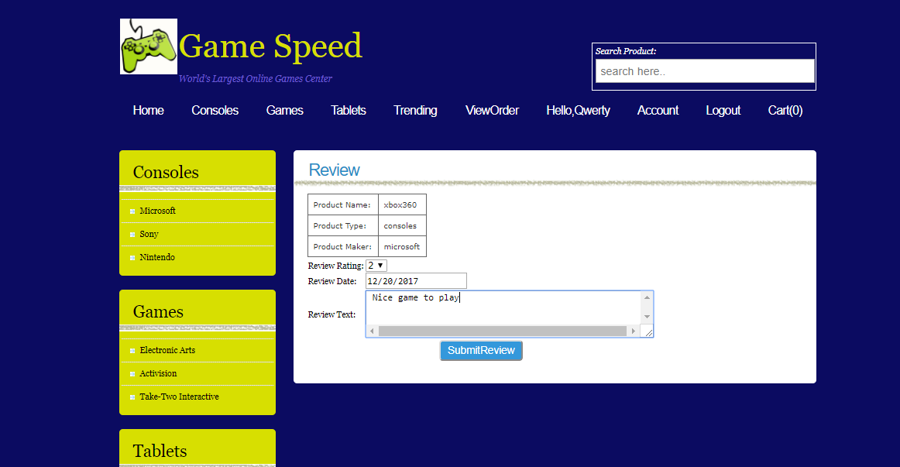
6. Example – Write Review:
On clicking the WriteReview Button from products page user will be directed to WriteReview webpage where he can give review for product.
Click the SubmitReview button to store the review in Mongo database

Slide 29
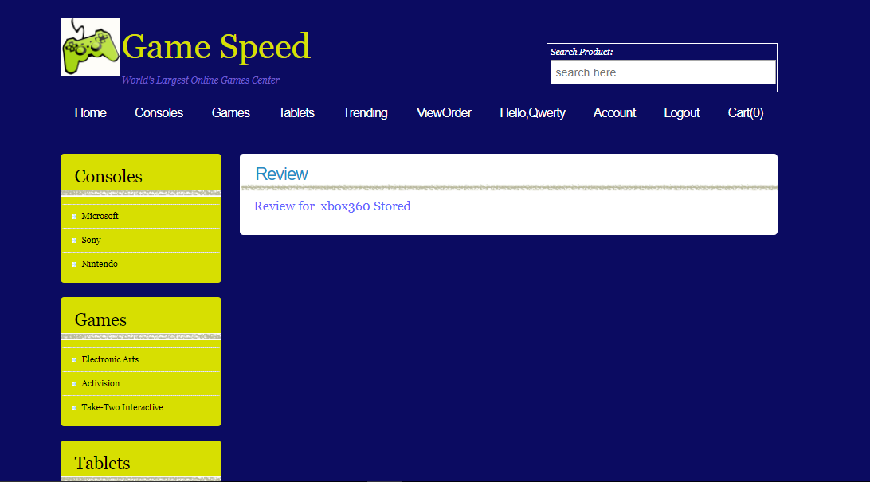
6. Example – Write Review:
On clicking the SubmitReview button user will get response that reviews for product is stored in database

Slide 30
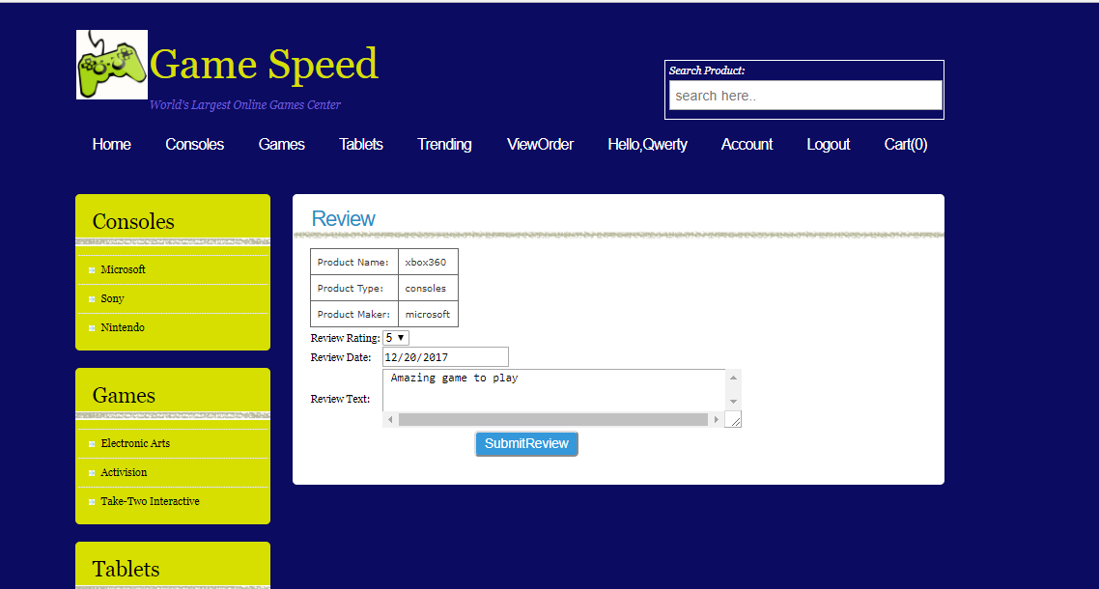
6. Example – Write Review:
Submitting one more Review for product

Slide 31
6. Example – Write Review:
On clicking the SubmitReview button user will get response that reviews for product is stored in database

Slide 32
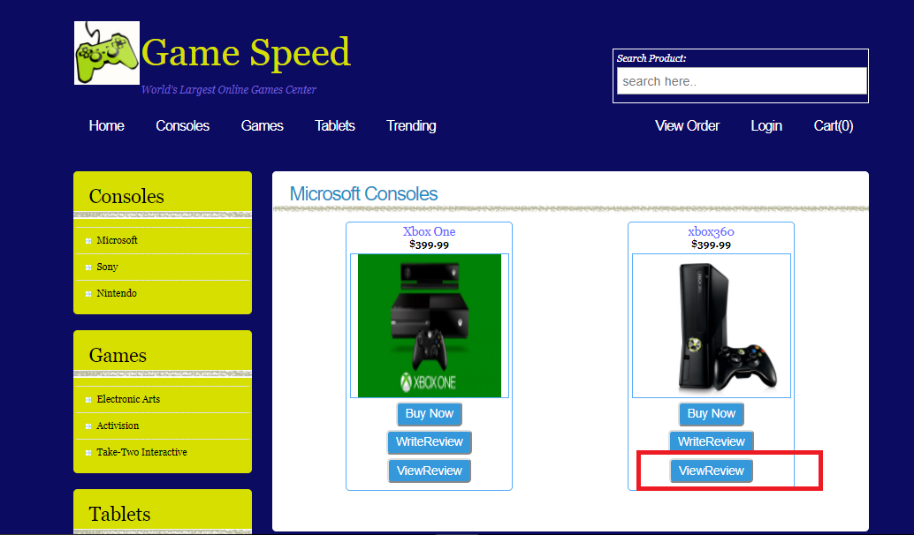
6. Example – View Review:
You can view the review submitted by clicking on ViewReview button on products page

Slide 33
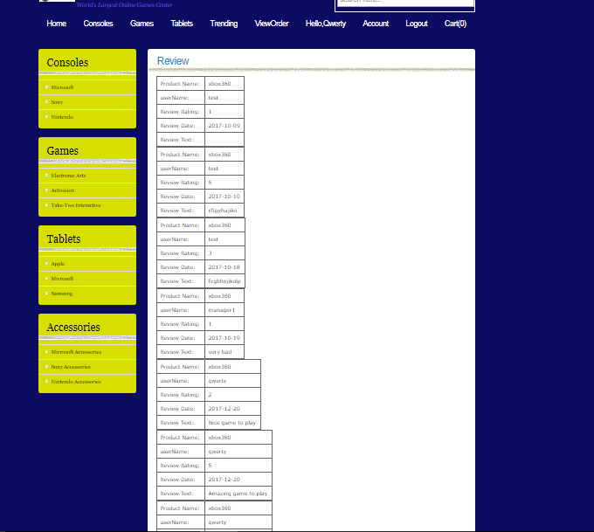
6. Example – View Review:
All the reviews for the product will be retrieved from mongo db and displayed in web page
Both the reviews are showed in web page

Slide 34
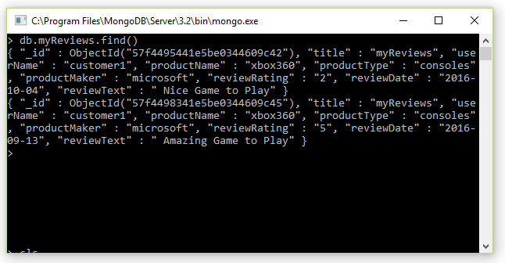
6. Example – View Review:
Check in the mongo shell if the myReviews collection is created inside example database and data for two reviews is stored in it

Slide 35
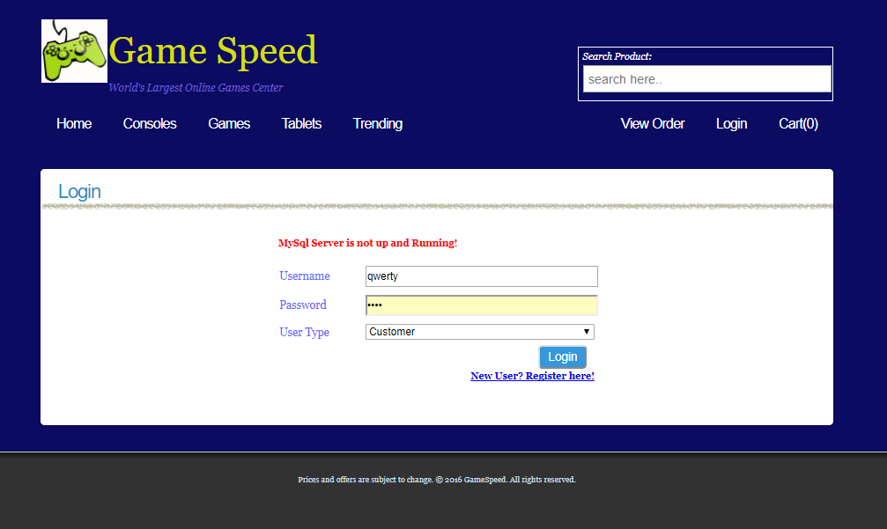
6. Example – Server Not Running For Registration:
Trying to Register when server is not up and running
If mySql server not running gives an error message

Slide 36
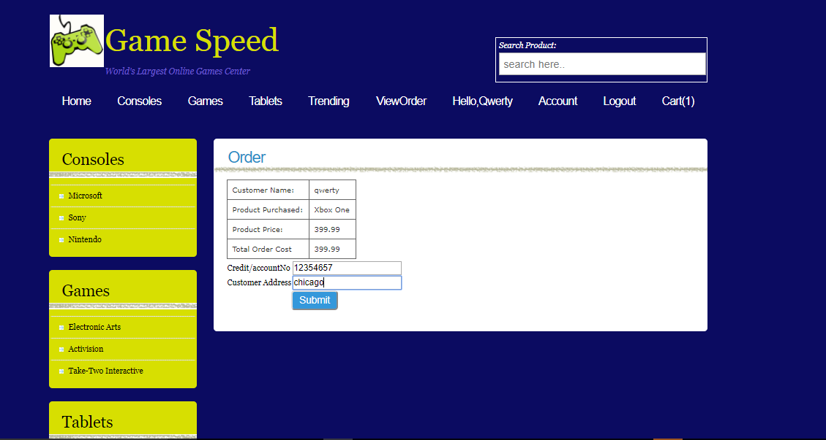
6. Example – Server Not Running For Orders:
Trying to Place order when server is not up and running

Slide 37
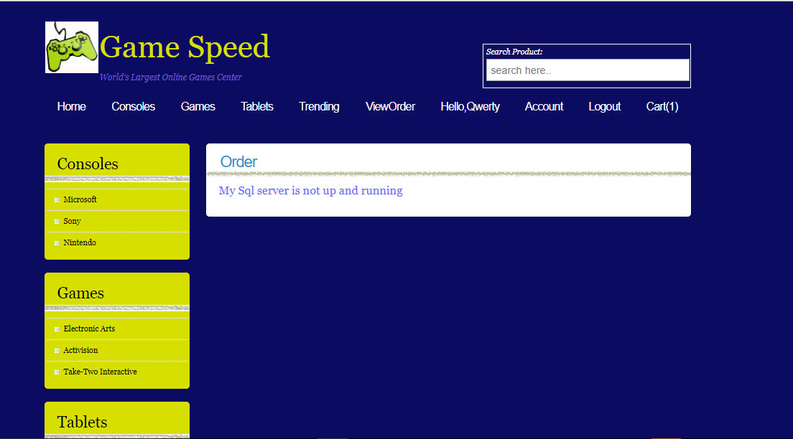
6. Example – Server Not Running For Orders:
Trying to Place order when server is not up and running
If MySql server not running gives an error message

Slide 38
6. Example – Write Review when MongoDb Server not running:
Trying to submit review for Product

Slide 39
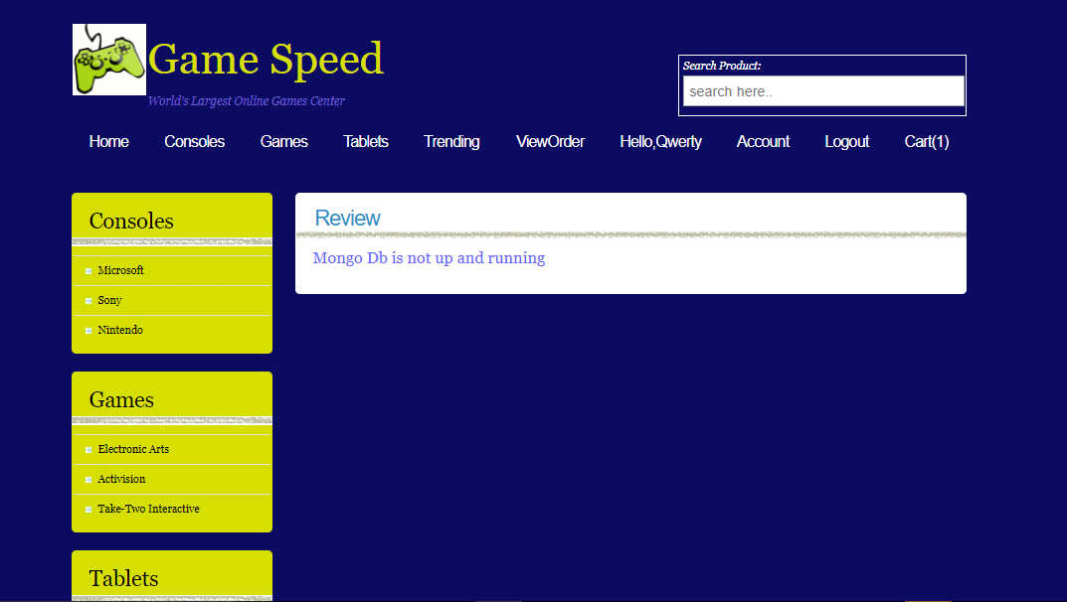
6. Example – Write Review when MongoDb Server not running:
Trying to submit review for Product
If MongoDb server not running gives an error message

Slide 40
6. Example – View Review when MongoDb Server not running:
Trying to view review for Product

Slide 41
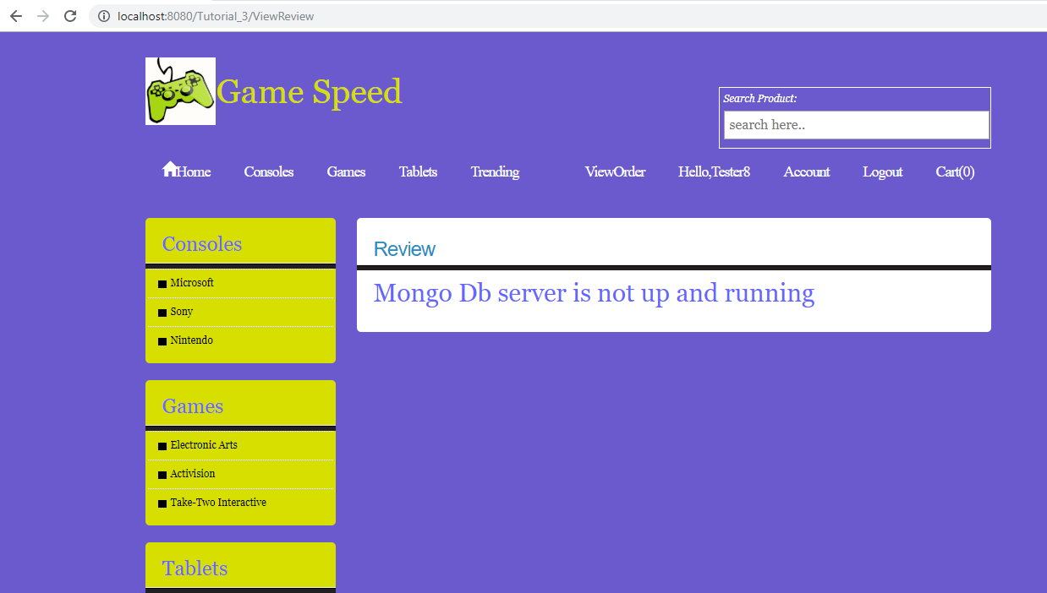
6. Example – View Review when MongoDb Server not running:
Trying to view review for Product
If MongoDb server not running gives an error message

Slide 42
6. Example – Write Review when MongoDb Server not running:
Trying to submit review for Product
If MongoDb server not running gives an error message

Slide 43
7. Code Snippet
Walkthrough to get connect to Database from Servlet

Slide 44
MongoDBDataStoreUtilities class to connect Database from Servlet
public class MongoDBDataStoreUtilities
{
static DBCollection myReviews;
public static void getConnection()
{
MongoClient mongo;
mongo = new MongoClient("localhost", 27017);
DB db = mongo.getDB(“CustomerReviews");
myReviews= db.getCollection("myReviews");
}
Connecting to CustomerReviews database
Getting Reviews data to DbCollection object

Slide 45
Walkthrough for Storing Reviews Code Snippet

Slide 46
Walkthrough for Storing reviews
public void storeReview(String productname,String producttype,String reviewrating,String reviewdate,String reviewtext)
{ HashMap<String, ArrayList<Review>> reviews= new HashMap<String, ArrayList<Review>>();
try
{reviews=MongoDBDataStoreUtilities.selectReview();}
catch(Exception e)
{ }
if(!reviews.containsKey(productname)){
ArrayList<Review> arr = new ArrayList<Review>();
reviews.put(productname, arr);
}
ArrayList<Review> listReview = reviews.get(productname);
Review review = new Review(productname,username(),producttype,reviewrating,reviewdate,reviewtext);
listReview.add(review);
try
{ MongoDBDataStoreUtilities.insertReview(productname,username(),producttype,reviewrating,reviewdate,reviewtext);
}
catch(Exception e)
{ }
}
Calling utility function to select data from database and storing reviews in hashmap
Calling utility function to inserting reviews in database

Slide 47
Utility Function for Selecting Review Data into Hashmap
public static HashMap<String, ArrayList<Review>> selectReview()
{
getConnection();
HashMap<String, ArrayList<Review>> reviewHashmap=new HashMap<String, ArrayList<Review>>();
DBCursor cursor = myReviews.find();
while (cursor.hasNext())
{
BasicDBObject obj = (BasicDBObject) cursor.next();
if(! reviewHashmap.containsKey(obj.getString("productName")))
{
ArrayList<Review> arr = new ArrayList<Review>();
reviewHashmap.put(obj.getString("productName"), arr);
}
ArrayList<Review> listReview = reviewHashmap.get(obj.getString("productName"));
Review review =new Review(obj.getString("productName"),obj.getString("userName"),obj.getString("productType"),obj.getString("reviewRating"),obj.getString("reviewDate"),obj.getString("reviewText"));
listReview.add(review);
}
return reviewHashmap;
}
DBCursor used to store table data obtained from database in servlet
Iterate through Cursor and Store each review into class object

Slide 48
Utility Function for Writing Reviews into Mongo database
public static void insertReview(String productname,String username,String producttype,String reviewrating,String reviewdate,String reviewtext)
{
getConnection();
BasicDBObject doc = new BasicDBObject("title", "myReviews").
append("userName", username).
append("productName", productname).
append("productType", producttype).
append("reviewRating", reviewrating).
append("reviewDate", reviewdate).
append("reviewText", reviewtext);
myReviews.insert(doc);
}
Creating a BasicObject to insert data into database
Specifying each column to insert value
DbCollection.insert()
Will insert data into database

Slide 49
Questions?

